Slide 1
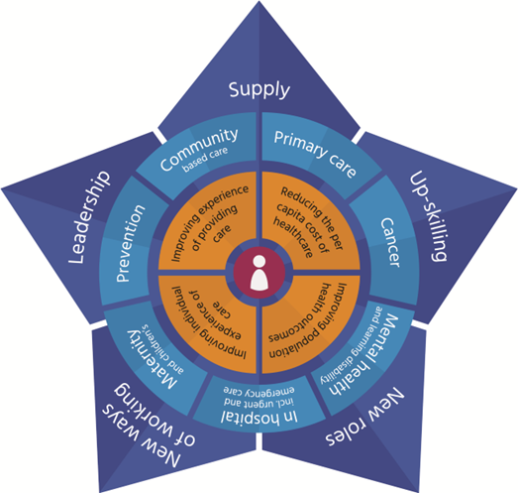
Understanding Attrition rates
Support staff health & return to work
International Recruitment
Placement expansion & new pathways into midwifery / increase sonographer cohorts
Student Support in place
Focused support for MW’s at the beginning and end of their carers
Media targeted recruitment campaign & Representation
RTP/ MSW Indeed recruitment offer
LMNS Workforce Strategy
Ensure PD Teams are resources sufficiently
Promote Staff development that is equitable
MSW Apprenticeship & bridging course / Framework
Sonographer training / Doppler
BOB Educational partnership
Meaningful appraisal training
Create environments that promote staff wellbeing
Succession planning & Talent pool
Staff Networks
Equity / Representation
Voice of our people
Support flexible working
High cost living area / Winter fuel impact
Health & Wellbeing
Advanced Clinical Practitioners
Social Prescribers
Legacy midwives
Specialist leadership Roles
Collaborative system working / BOB safety huddle
Staff Passports
Embed the building blocks for CoC / Core20Plus
(Health Education England )

